Slide 1
Hotel Reservation System
A brief presentation on purpose,instructions and usability of program
Project Members:
Saif ur Rehman Awan
Humza Zaheer
Abdul Moiz
Fahad Hussain

Slide 2
Features of program
Here are some features you can use in program.
The user can:
Book Multiple Rooms at once, and save of their data.
See how many Un-Occupied Rooms are available in your Hotel.
See the Details of All the Occupied Room's Customer.
Modify the Customer's Details.
Change the fare rate of each category.
Increase or Decrease the No. of Room of each category.
Search for one specific Customer.
Make the customer check-out, at any time.
See the Information about features of each category's room.
See the Credits (Developing Team and Core Purpose).
Exit the program at any time, with its own free will.

Slide 3
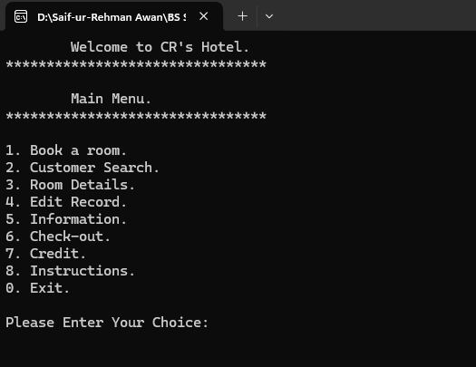
System Functionalities
In the main menu, following options are displayed which can be accessed by inputting the corresponding number:
1. Book a Room
2. Customer Search
3. Room Details
4. Edit Record
5. Information
6. Checkout
7. Credits
8. Instructions
0. Exit
Invalid Entry Will prompt User to Enter Number between 0-8 Range.

Slide 4
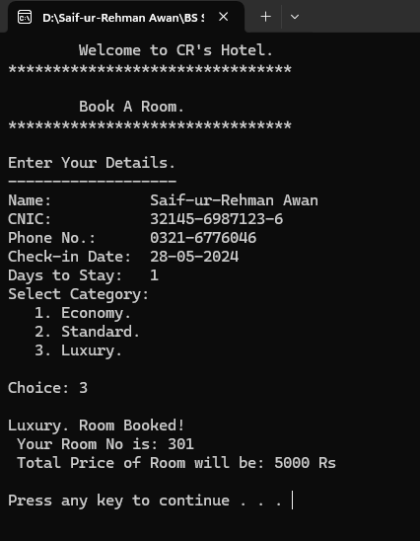
1. Booking A Room Menu
The Booking process compromises of Following:
Input customer details
Choose room category
Total price is calculated
Room number is allocated
Customer is marked As Checked in,
And hence Customer’s Data is stored

Slide 5
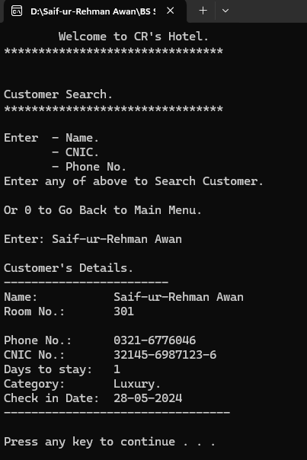
2. Customer Search
Search customers by name, CNIC, or phone number.
View customer details:
Name,
Room No,
CNIC,
Days to Stay,
Check-in Date,
Phone Number.
Press any key to return to Main Menu.

Slide 6
3. Room Details
Displays available rooms category-wise.
User can View customer check-in list with:
Room Numbers
Names
CNIC
Date of Check in
Total fare

Slide 7
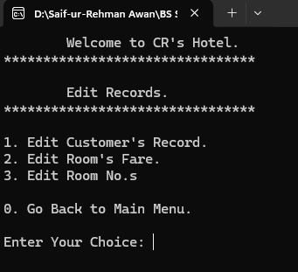
4. Edit Records
Edit customer data.
Room fare.
Number of rooms.
Options:
Customer's Data Edit.
Room Fare Edit.
Edit No. of Rooms.
Use "0" to go back to previous sub-menu.

Slide 8
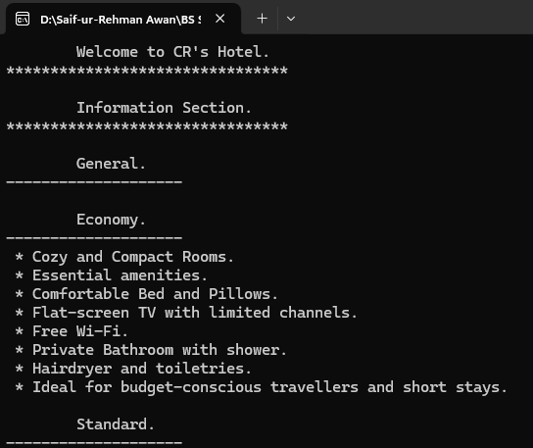
5. Information
Display room information category-wise:
Economy.
Standard.
Luxury.
Information is provided in bullet points,
for easy reading.

Slide 9
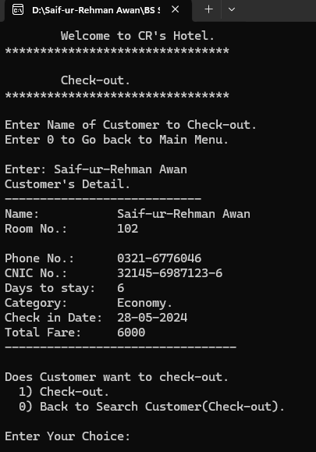
6. Checkout
Enter customer name to check out.
Program Displays customer details And total bill.
After Confirming Checkout payment options
are displayed.
Incase of Invalid name in checkout program
will Display Customer Not in Hotel Check-in list.
Press 0 to go back to previous menu.

Slide 10
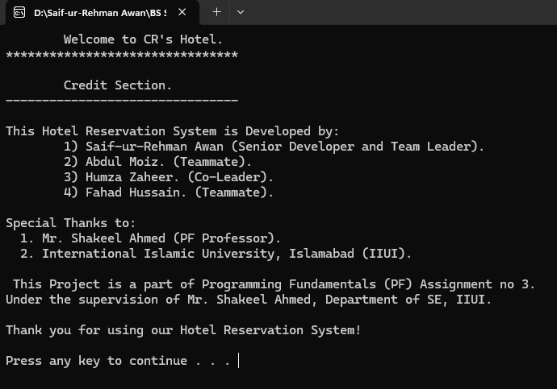
7. Credits
Displays Information about the:
Developing team,
Supervisor,
Institute,
Acknowledge purpose of building
the program.

Slide 11
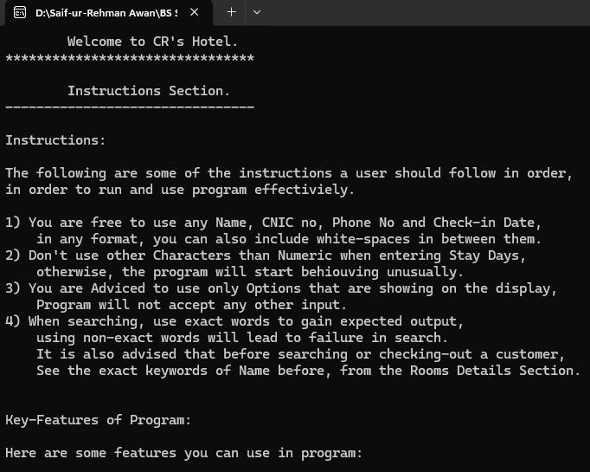
8. Instructions
Provide user-friendly instructions for
program usage.
Instructions will help those users which
are newly familiar to use the program.
Explain features in simple language,
so that User can understand Easily.

Slide 12
0. Exit
Exits the program.
Press "0" to exit.

Slide 13
Final Credits
This Hotel Reservation System is part of project and is developed by:
1. Saif-Ur-Rehman Awan (Group Leader)
2. Humza Zaheer (Co-Leader)
3. Abdul Moiz (Group Member)
4. Fahad Hussain(Group Member)
Under Supervision of:
Mr. Shakeel Ahmed (PF Professor).
International Islamic University, Islamabad.

